Slide 1
IoT in I4.0 and HC4.0
Elia Tonoli – Daniel Amadori - Franco Fummi
Version 2.2

Slide 2
Outline
IoT in Industry 4.0
the communication
IoT vs. Industrial IoT
IoT in HC4.0
sources of information
IoT vs. IoMT
(I)IoT Stack
Commercial solutions
An industrial use case: ICE Laboratory
An HC4.0 use case

Slide 3
IoT in Industry 4.0
The communication and IIoT

Slide 4
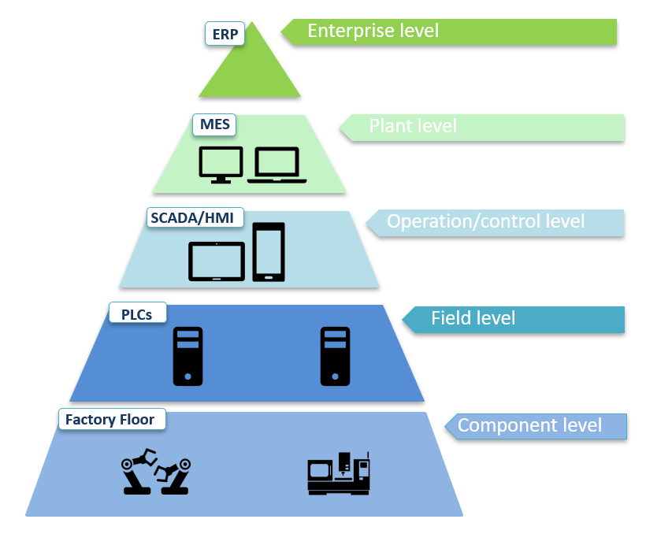
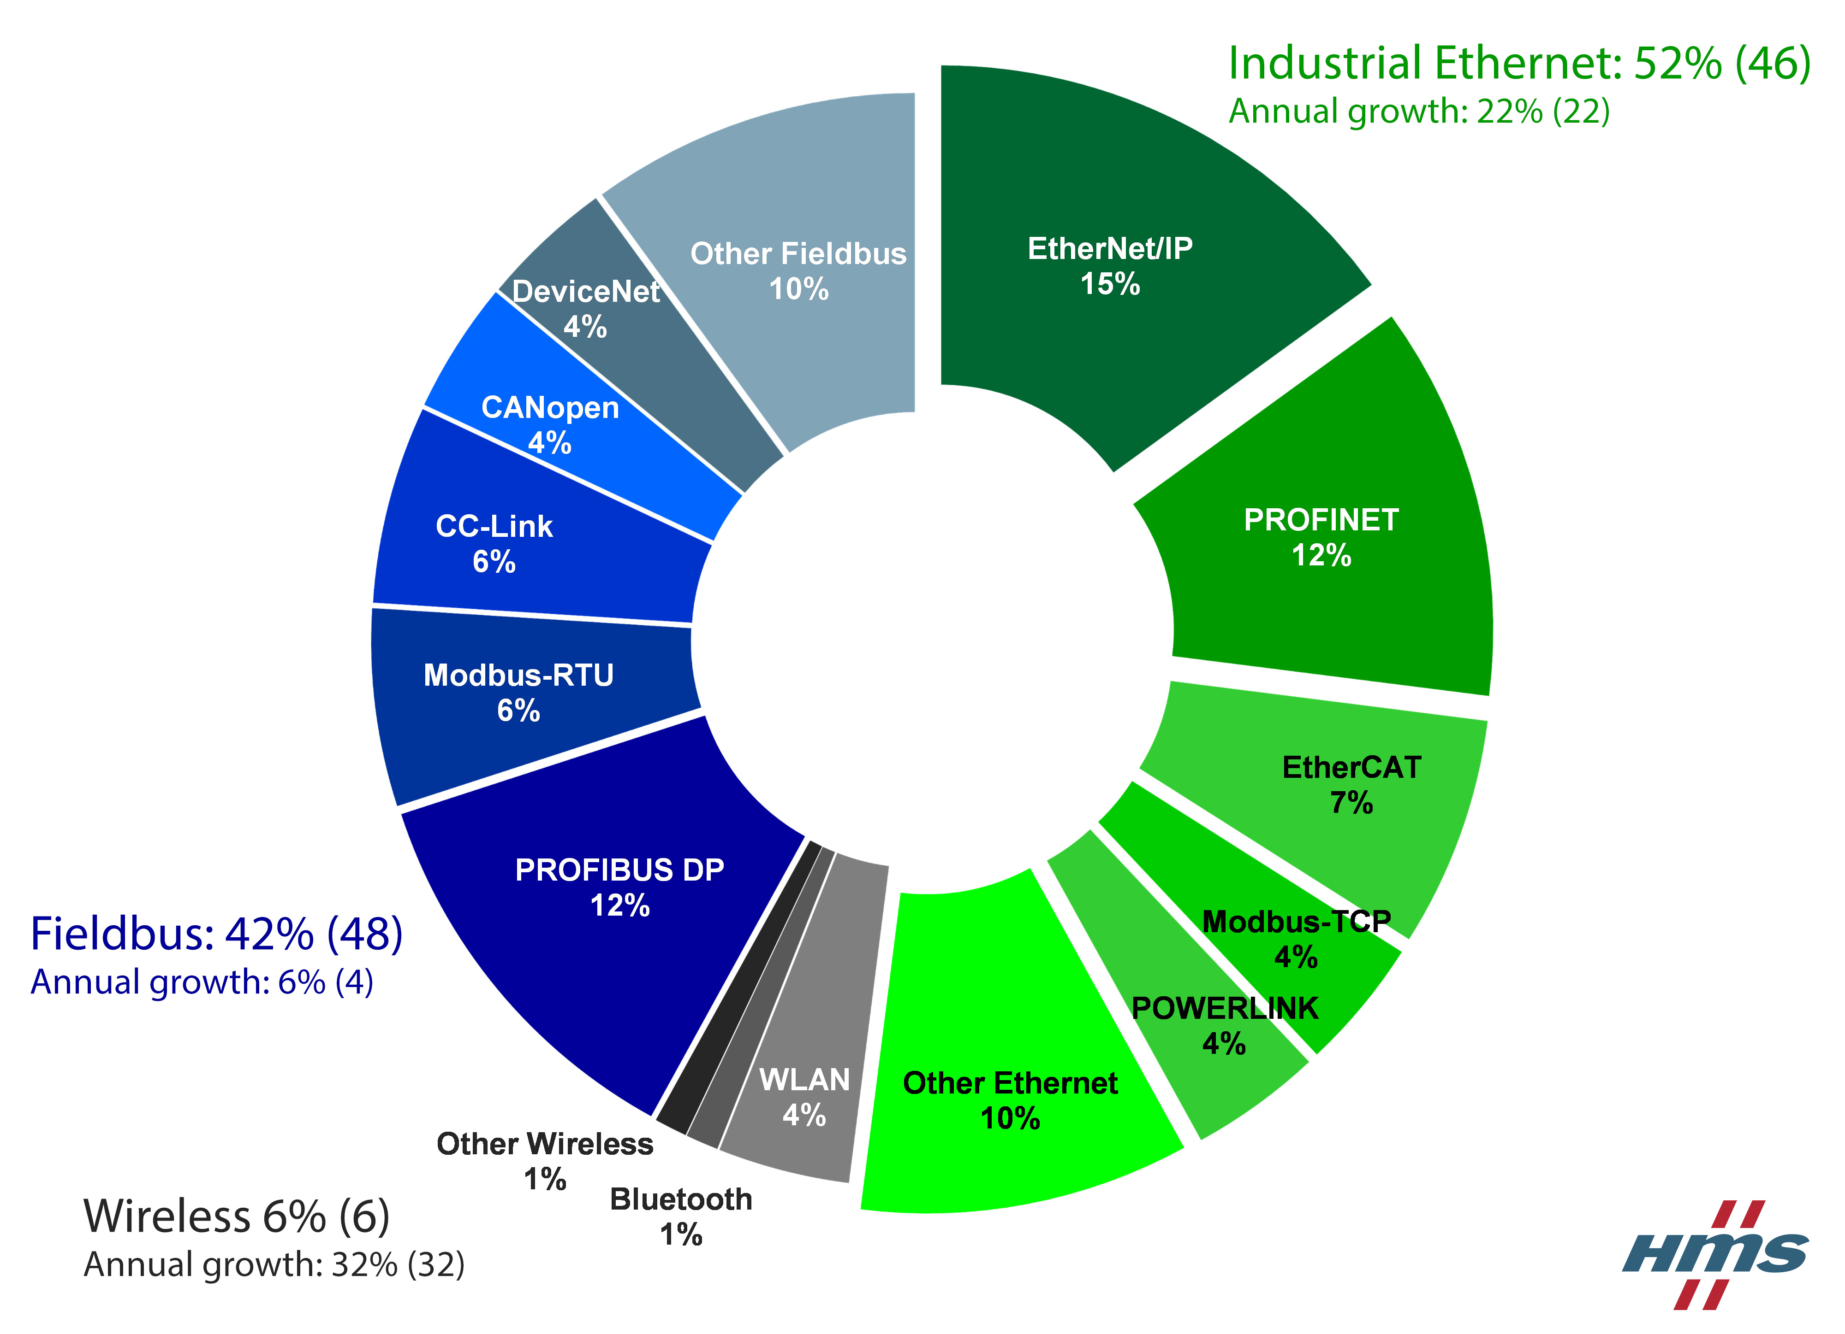
Industry 4.0 and the communication
months
days
Standard automation pyramid
from actuators and sensors to enterprise systems
result of the Third Industrial Revolution
At the lowest level, different vendors provide different fieldbus protocols
Fielbuses like Profibus DP, Modbus-RTU
Industrial Ethernet networks like PROFINET, EtherCAT, Modbus TCP, EtherNet/IP
Challenge: communication technology for all the levels of the pyramid.
hours
minutes
Time constraints
seconds
µs/ms
Notes:
Una fabbrica d’automazione, per funzionare correttamente, viene suddivisa per livelli. Questi livelli sono rappresentati dalla piramide d’automazione.
Il livello più basso è il livello che svolge i lavori fisici. È composto da dispositivi, attuatori e sensori.
Il field level usa i dispositivi del livello inferiore per controllare la produzione. Principalmente, questo livello una volta ricevuto i dati dai vari dispositivi, prende le decisioni per completare un determinato compito. In questo livello troviamo i PLC che sono computer che eseguono questo compito di monitoraggio e decisione.
Il livello superiore, Supervisory level, utilizza SCADA che è una combinazione dei livelli precedenti usati per accedere ai dati e ai sistemi di controllo da una locazione remota. Principalmente SCADA è un computer che si interfaccia con i PLC per accedere ai dati utili per svolgere analisi.
Il planning level utilizza un computer che si chiama Manufacturing Execution System (MES). Questo monitora l’intero processo di produzione dal livello più basso fino al suo livello. Questo monitoraggio, permette di vedere effettivamente cosa sta succedendo nella fabbrica e di conseguenza prendere le decisioni giuste considerando i dati.
La punta della piramide, enterprise level, utilizza Enterprise Resource Planning (ERP) che è un insieme di SW che analizza tutti processi di un’azienda. Si tratta di un sistema di gestione che integra tutti i processi di business rilevanti di un'azienda (vendite, acquisti, gestione magazzino, contabilità ecc.).
I livelli più bassi della piramide sono collegati tra di loro tramite le reti industriali. Queste, a differenza delle reti classiche che abbiamo a casa o in ufficio, devono avere certe caratteristiche per essere utilizzate. Infatti, in questo livello i vari dispositivi hanno tempi di risposta molto brevi e la comunicazione deve essere sicura e quindi vi è la necessità di avere una comunicazione con una latenza bassa e che sia deterministica in quanto Ethernet è non-deterministica il che potrebbe causare perdita di dati e come conseguenza il processo di produzione potrebbe avere comportamenti errati. Per questi motivi, i vari produttori hanno creato diversi fieldbus. Ma questo principalmente è un problema in quanto ci sono diversi standard in circolazione e quindi, in caso di inserimento di nuovi device, questi devono essere compatibili il fieldbus utilizzato. Principalmente ci sono due categorie: fieldbus e industrial ethernet.
Negli ultimi anni la IEEE ha standardizzato un nuovo protocollo che si basa su Ethernet che è in grado di sostituire tutti questi protocolli siccome tutti hanno requisiti simili. Questo nuovo protocolo si chiama Time-Sensitive Networking (TSN) e principalmente questo permette di avere una comunicazione real-time deterministica.
Quindi, vi è la necessità di avere uno standard di comunicazione che sia in grado di coprire tutta la piramide e che sia vendor-independent, ovvero non dipenda da un particolare veditore.
Una fabbrica d’automazione, per funzionare correttamente, viene suddivisa per livelli. Questi livelli sono rappresentati dalla piramide d’automazione. Questa piramide è una rappresentazione dei diversi livelli di automazione in una fabbrica.

Slide 5
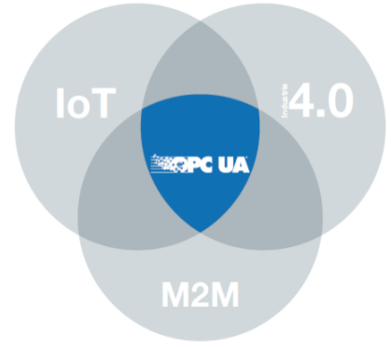
Solution: OPC Unified Architecture
Designed for secure, reliable and interoperable M2M communication
Service oriented architecture (SOA) follows the
request/response paradigm.
OPC UA offers two communication patterns:
Client/Server
Publish/Subscribe
Broker
(MQTT, AMQP)
Publisher
(Server)
Subscriber
(Client)
Message Oriented Middleware
Request
Publisher
(Server)
OPC UA Server
OPC UA Client
Subscriber
(Client)
Reply
Broker-less
(UDP, ETH)
Publisher
(Server)
Subscriber
(Client)
Notes:
La soluzione è offerta da OPC UA. Ma con il classico modello client/server, che negli anni è diventato uno standard per i livelli superiori della piramide, non era abbastanza performante per rimpiazzare le differenti tecnologie presenti nel livello più basso della piramide che, come sappiamo devono essere deterministici ed a bassa latenza. Di conseguenza, la OPC Foundation nel marzo 2018 ha rilasciato un’ulteriore specifica che si aggiunge alle altre 13 già presenti, ed introdusse un nuovo modello di comunicazione chiamato OPC UA PubSub.
In questo schema ci sono due attori: publisher e subscriber. Il primo è quello che produce informazioni e il secondo è quello che le consuma. L’obiettivo principale di questo pattern di comunicazione è quello di disaccoppiare la comunicazione diretta tra i vari publisher e sub, infatti un publisher non ha bisogno di sapere chi ha necessita le sue informazioni e il sub sa solo quali informazioni ha bisogno senza sapere come vengono inviate a lui. Questo modello è scalabile, Infatti, permette una comunicazione uno a molti e molti a molti. Per far comunicare questi i vari pub con i vari sub si utilizzano i MOM. Questi principalmente hanno l’obiettivo di fare da tramite. Il mittente di un messaggio non deve essere consapevole dell'identità dei destinatari esso si limita a "pubblicare" il proprio messaggio al MOM. I destinatari si rivolgono a loro volta al MOM "abbonandosi" alla ricezione di messaggi. Il MOM quindi inoltra ogni messaggio inviato da un publisher a tutti i subscriber interessati a quel messaggio. In genere, il meccanismo di sottoscrizione consente ai subscriber di precisare nel modo più specifico possibile a quali messaggi sono interessati. Per esempio, un subscriber potrebbe "abbonarsi" solo alla ricezione di messaggi da determinati publisher, oppure aventi certe caratteristiche.
Nella specifica del PubSub di OPC, inoltre, è possibile distinguere due tipologie di MOM: Broker-based e broker-less.
Broker-based è il classico dispatcher che viene utilizzato dalle applicazioni. Qui, vi è un server che fa da tramite e i messaggi sono gestiti tutti da lui. Offre code in cui publicare e sottoscrivere aggiornamenti.
Broker-less come dice il termine non utilizza il broker ovvero un terzo attore che fa da tramite. Infatti, qui si utilizza l’infrastruttura della rete (switch, router) e indirizzi multicast per comunicare con i vari attori. Principalmente, il messaggio viene consegnato a tutti quelli che appartengono ad un certo indirizzo multicast. Il due vantaggi di questa tipologia: non necessità di hw aggiuntivo per la funzione di mom, e riduzione overhead e latenza grazie alla comunicazione diretta senza un terzo elemento.

Slide 6
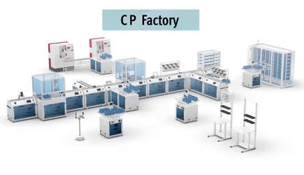


Problems to be faced
1
Role of OPC UA PubSub in Industry 4.0
Best communication model for a specific industrial scenario.
2
3
Best OPC UA PubSub configuration to meet the requirements of the scenario.
Client/server
PubSub
5G
TSN
4
Integration of OPC UA PubSub with new technologies.
5
Automatic configuration of PubSub environment.
Notes:
N.B: NON CI SONO LAVORI!

Slide 7

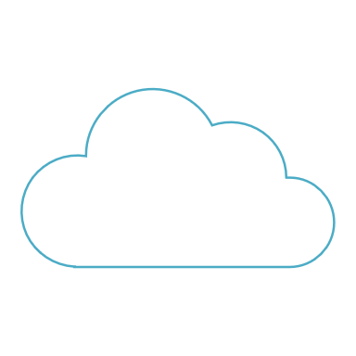
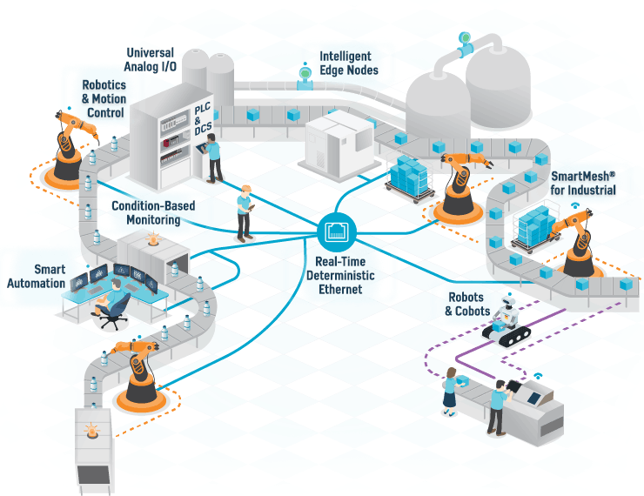
Client/Server VS PubSub
Different aspects are considered when choosing the best model:
Real-time requirements
Information fan-out
Computational resources
Cloud integration
Analysis confirmed PubSub’s applicability in:
Cloud scenarios
Real-time scenarios
Cloud
PubSub
Client/server
OPC-UA
OPC-UA
OPC-UA
OPC-UA

Slide 8
IoT vs. Industrial IoT - I
Communications:
IoT devices use standard IT protocols like Wi-Fi, Ethernet, …
IIoT devices must support industrial protocols like Profinet, Ethercat, …
Safety and Security:
IoT devices access the Internet directly, so they must be secured
IIoT devices live in the OT network, so they must take care of safety rather than security
Reliability:
it is not so critical for IoT devices
IIoT devices must guarantee high reliability to keep safe the production plant
Notes:
IT protocols Wifi, Eth, Zigbee VS Profinet, Ethercat, (wireless ?)
IoT secures data, IIoT secures the plant keeping it safe
If IoT becomes broken, nothing happen, IIoT could damage a plant

Slide 9
IoT vs. Industrial IoT - II
Architecture:
IoT devices communicate with a public cloud to access user information
IIoT devices uses a private or hybrid cloud which contains company data
End devices:
IoT devices sense data (like steps, blood pressure, …) for a consumer-type ecosystem
IIoT devices provide precise measures to both cloud and PLCs
Costs:
IoT devices must be as cheap as possible
IIoT devices need to be certified so their cost can be slightly higher
Notes:
4. Different kinds of data are stored in cloud, less and more personal
5. IoT senses data for a post processing in cloud, IIoT is usually into a feedback loop control so they must guaratee certain performance
6. IoT must be very cheap, IIoT must be cheap but they must be certified

Slide 10



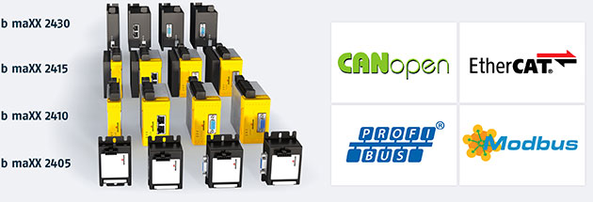



Industrial IoT Architecture
IIoT Gateways
Common standard
between OT protocols
OPC UA
SERVER
OPC UA
SERVER
OPC UA
SERVER
Notes:
Industrial Architecture (according to Siemens ?): every machine is equipped with sensors and hosts an OPC UA server which exports the current status
Special IoT gateways are OPC UA client: they connects with the machines’ servers and extract the requested values
They act as a bridge between the cloud and the production line

Slide 11
IoT in HC4.0
Internet of Medical Things (IoMT)

Slide 12
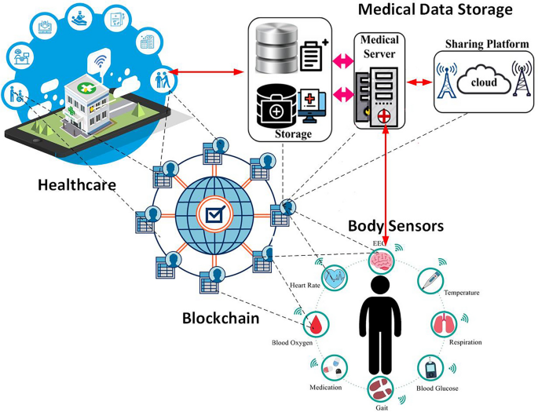
IoMT – Internet of Medical Thing
IoMT is composed of all devices that are connected to a network and are capable of
generating,
collecting,
analyzing, and
communicating medical data
The purpose of IoMT is to make all health services more efficient for operators and patients

Slide 13
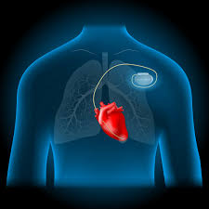
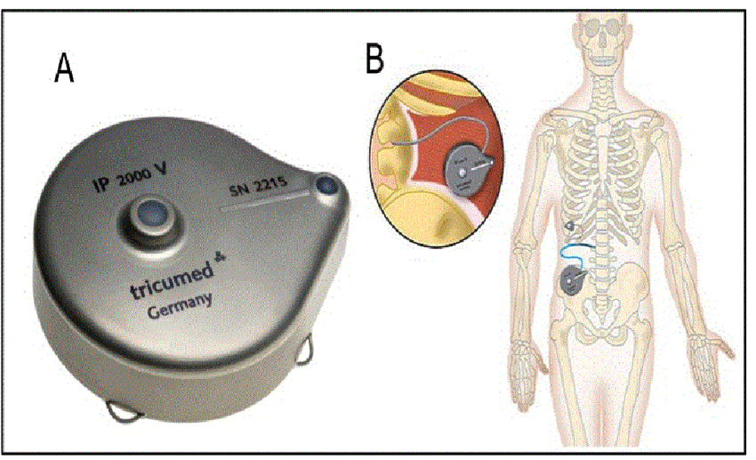
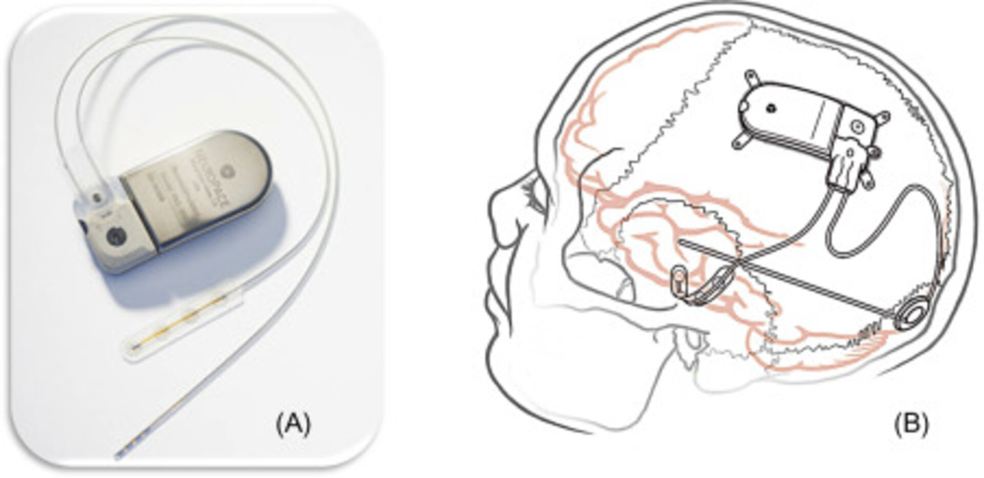
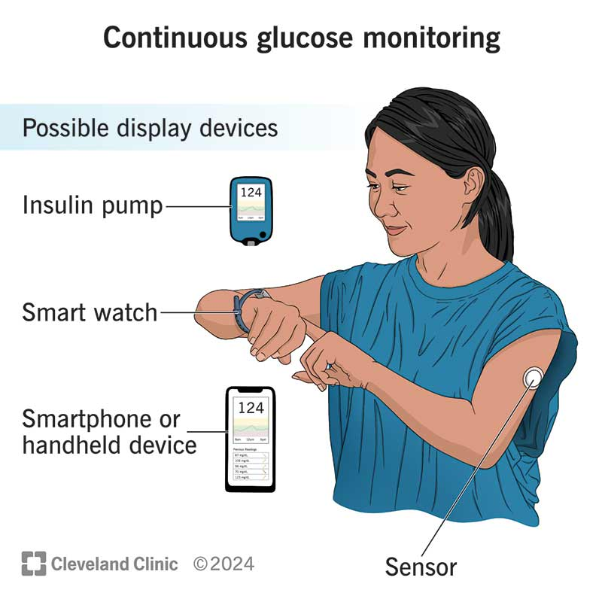
IoMT: in-body devices
They are wearable and implantable devices
They monitor physiological data such as:
blood pressure,
heart rate,
body temperature,
glucose levels,
oxygen saturation
Equipped with remote communication capabilities, they are used for telemedicine and hospital monitoring
Examples include:
pacemakers,
implantable infusion pumps,
neurostimulators,
continuous glucose monitors

Slide 14
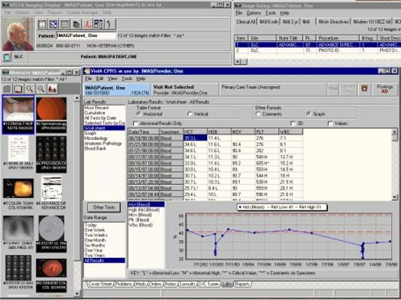
IoMT: in-home and in-clinic devices
In-home devices:
they are mainly designed to monitor patients at home
either those with chronic conditions or
those recovering after hospital discharge
In-clinic devices:
they are used within healthcare facilities for
monitoring,
administrative tasks, or
integration with electronic health records (EHRs)

Slide 15
IoMT: Main Goals
Better management of pharmaceutical products:
connected devices enable precise monitoring and
optimization of medication use,
reducing errors and ensuring accurate administration
Improved patient experience:
innovative technologies enhance patient comfort and
quality of healthcare, whether at home or in clinical settings
Better patient outcomes:
continuous monitoring and personalized treatment lead to more positive health results.
Improved diagnosis and treatment:
IoMT devices provide real-time data and advanced analytics,
helping healthcare professionals make faster and more accurate decisions
Remote monitoring of chronic diseases:
facilitates more effective management of long-term conditions,
reducing the need for in-person visits
Better disease management:
continuous tracking helps prevent complications and
allows for timely interventions when needed

Slide 16
IoMT: sources of information
Wearable Devices:
Monitor physiological parameters such as heart rate, blood pressure, and glucose levels
Examples: Smartwatches and fitness trackers
Implantable Devices:
Operate within the body to monitor and manage health conditions
Examples: Pacemakers and insulin pumps
3. In-Home Medical Devices:
Designed for home use to monitor health status
Examples: Blood pressure monitors and glucose meters.
4. Clinical Devices:
Used in healthcare facilities for diagnostics and patient monitoring.
Examples: MRI machines and patient monitoring systems.
5. Healthcare Applications:
Software platforms that collect and analyze data from various medical devices.
Examples: Electronic Health Records (EHR) systems.

Slide 17
IoT vs. IoMT
Differences:
Purpose:
IoT: Broad range of devices across various industries
IoMT: Focused on medical devices and healthcare applications.
Data Sensitivity:
IoT: General data like environmental conditions.
IoMT: Sensitive healthcare data, complying with GDPR and HIPAA.
Security Requirements:
IoT: Varies by application.
IoMT: Demands higher security standards for patient safety.
Similarities:
Both involve interconnected devices collecting and transmitting data
Utilize technologies like sensors, cloud computing, and data analytics
Enhance efficiency and decision-making through real-time data insights

Slide 18
(I)IoT Stack
Notes:
Let’s talk about the layers that compose an IoT solution

Slide 19
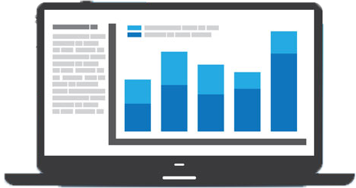
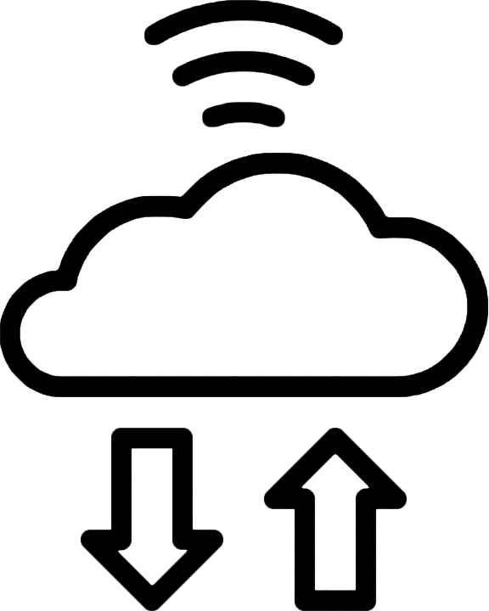

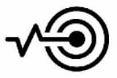
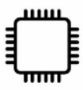
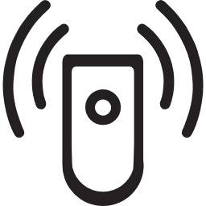
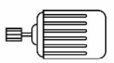
(I)IoT Solution - Layers
An IoT solution is composed of many layers:
4. analytics platform
3. core platform
2. communication protocols / device gateway
1. device layer
Security
Management
Notes:
device: the things that are dislocated in our homes, on production lines, on the streets, …
The ways in which the things communicate between each others and to the cloud
Core: situated in the cloud, provides enough processing power, storage and network capabilities to communicate with the things
Analytics: in the cloud, all the services that allow to make reports, aggregate data, …

Slide 20
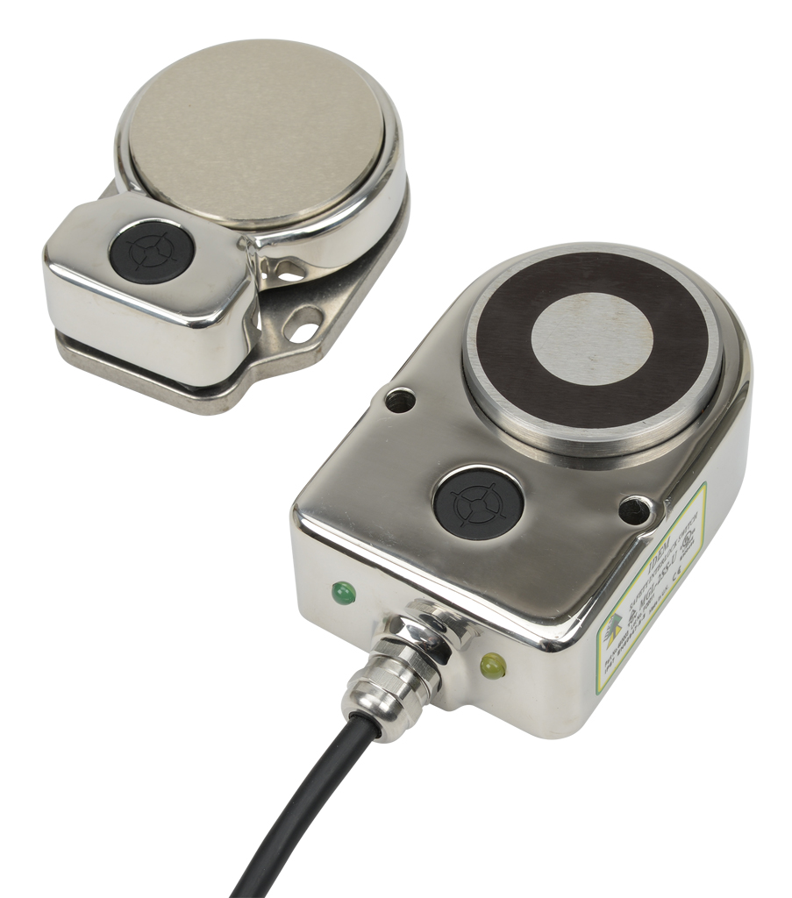
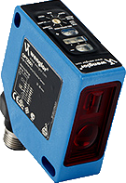
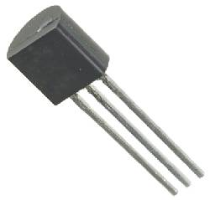
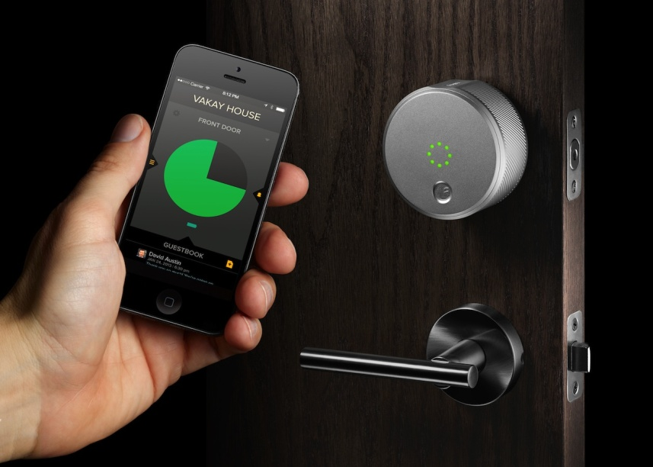
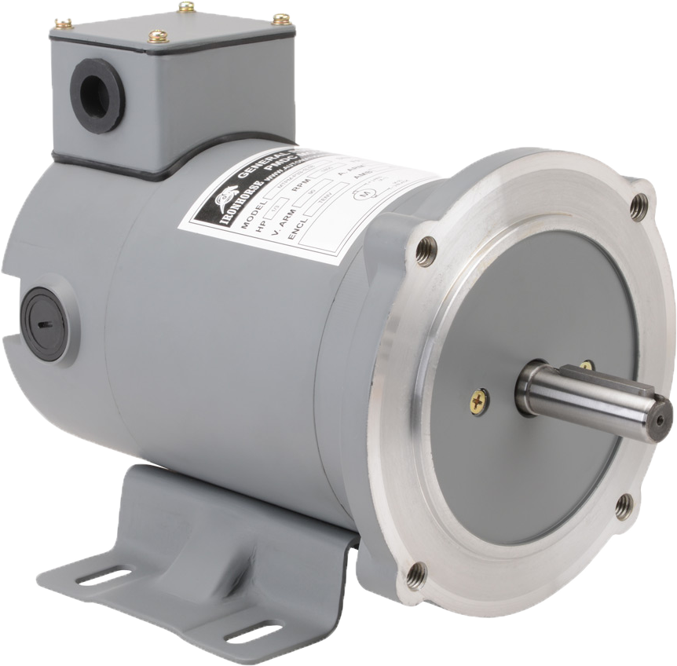
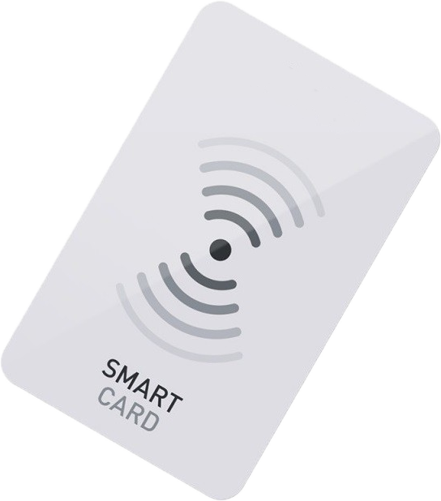
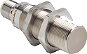
(I)IoT Solution - Device Layer
Devices are the things of the (I)IoT
small devices with a microcontroller and one or more sensors / actuators
Sensors
are programmed to sense environmental parameters
low power
Actuators
act with the physical world according to the input received
motion, lighting, emitting sound, controlling power, …
Tagged Devices
communicate wireless
RFID (Radio Frequency Identification)
NFC (Near Field Communication)
Beacons w/ Bluetooth LE
Notes:
Devices are the things: small with a minimum processing power, a way to communicate with the network, and sensors/actuators
…

Slide 21

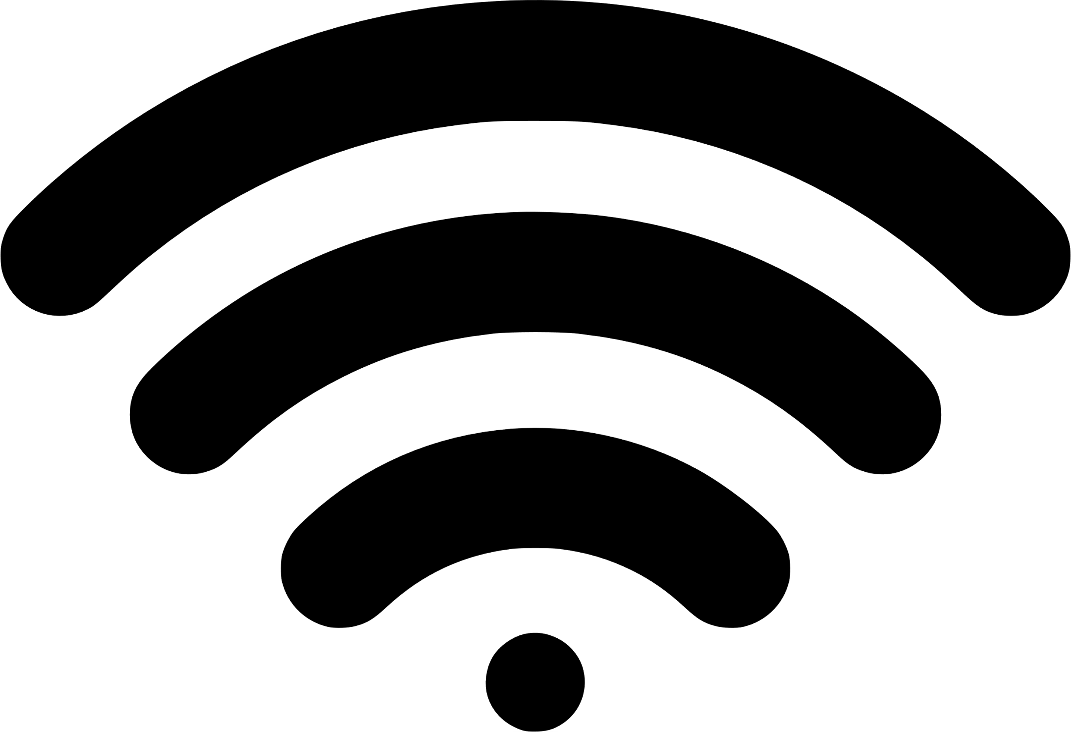
(I)IoT Solution - Communication Layer - I
Two communication strategies:
Direct Internet Access
device has the capabilities to access directly the Internet
using wireless or wired protocols:
Wifi
Ethernet
Cellular (2G, 3G, LTE, 5G)
Internet access through gateway
device cannot access directly the Internet
a gateway/smartphone is needed
protocols between node and gateway:
Bluetooth / Bluetooth LE
RFID
NFC
Zigbee
Notes:
Regarding communication, we have two main strategies: direct and gateway internet access
The gateway in some cases is a smartphone (example in Smart Healthcare: the smartphone collects data from the thing and uploads them to the cloud)

Slide 22


(I)IoT Solution - Communication Layer - II
Two main application protocols:
MQTT/AMQP protocols
small payload
machine-to-machine (M2M) protocols
client - server / publisher - subscriber
needs a broker that handles message delivery
work over a TCP connection
OPC UA protocol
industrial automation standard (IEC 62541)
interoperability between industrial pyramid layers
client - server / publisher - subscriber
well defined data model
works over any kind of transmission
Notes:
Applicative protocols: IoT typical MQTT/AMQP, with very small footprint. Client server model with pub sub of messages.
Needs only a connection: different QoS available
OPC UA emerging standard in industry! Aims to realise interoperability between different solutions (Siemens, Bechoff, …) -> client server/pub sub models with a well defined data model

Slide 23
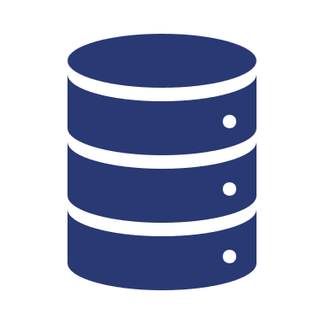



(I)IoT Solution - Core Platform - I
Located in the cloud, provides a set of capabilities to monitor and control IoT devices and to process incoming data
Protocol Gateway
Messaging Middleware
Data Filtering
Notes:
The core is situated in some cloud, like Microsoft Azure, Amazon AWS, …
Different layers. The first is the protocol gateway, which allows the cloud to support multiple IoT protocols, translating the automatically.
Messaging Middleware perform message passing between nodes.
Data filtering can be enabled or not: allows to discard useless data or to perform aggregations
Finally, the mega database. (NoSQL typically)

Slide 24

(I)IoT Solution - Core Platform - I
Located in the cloud, provides a set of capabilities to monitor and control IoT devices and to process incoming data
Protocol Gateway
Messaging Middleware
Data Filtering
Cloud

Slide 25

(I)IoT Solution - Core Platform - II
Protocol Gateway
enables the core to support different protocols from devices
the platform internally uses one single protocol
(I)IoT Messaging Middleware
distributes messages across core and devices
highly scalable (buffering incoming data)
provides secure connectivity
Cloud

Slide 26


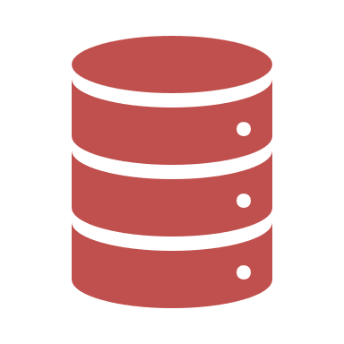
(I)IoT Solution - Core Platform - III
Data Aggregation and Filter
provides rules and complex conditions to filter out data
provides mapping techniques to extract models from raw data
device data contextualization
Data Storage
stores continuous data stream from devices
provides redundancy
Time Series database (NoSQL) like MongoDB, CouchDB, …

Slide 27
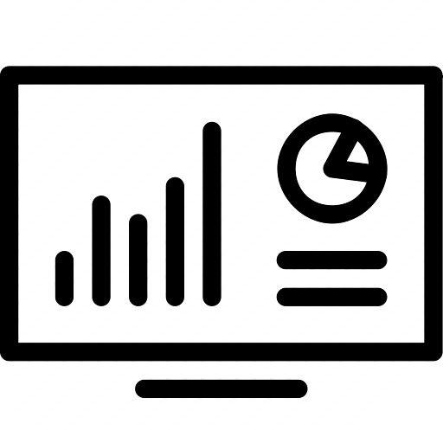
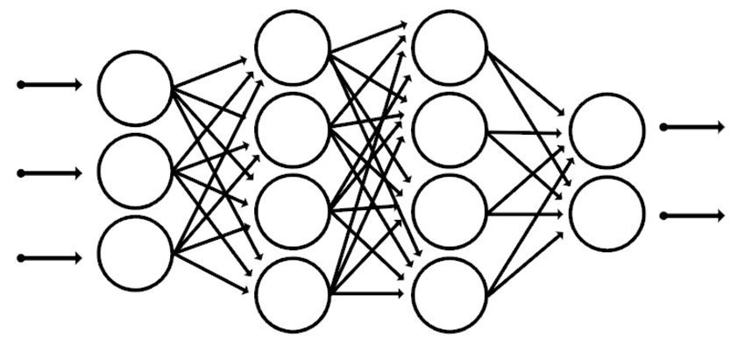

(I)IoT Solution - Analytics Platform
Allows to analyze data to derive insights and actions
Stream Processing
analyzes all incoming data
fault tolerant
scalable
supports interactive queries
triggers events
Machine Learning
makes computers learn from data without explicitly programming them
supervised learning
unsupervised learning
reinforcement learning
Events and Reporting
services that allows the connection between data and actions
trigger events
call external services
update dashboards in real time
Notes:
The analytics: three layers
1 Stream: analyze infos, compute them, aggregate data
2 Machine learning: ”how we make computers learn from data using various algorithms without explicitly programming it, so it can provide the required outcome”, three kinds
3 Services that invoke the required action based on analyzed data

Slide 28
Commercial Solutions
Examples on the market

Slide 29
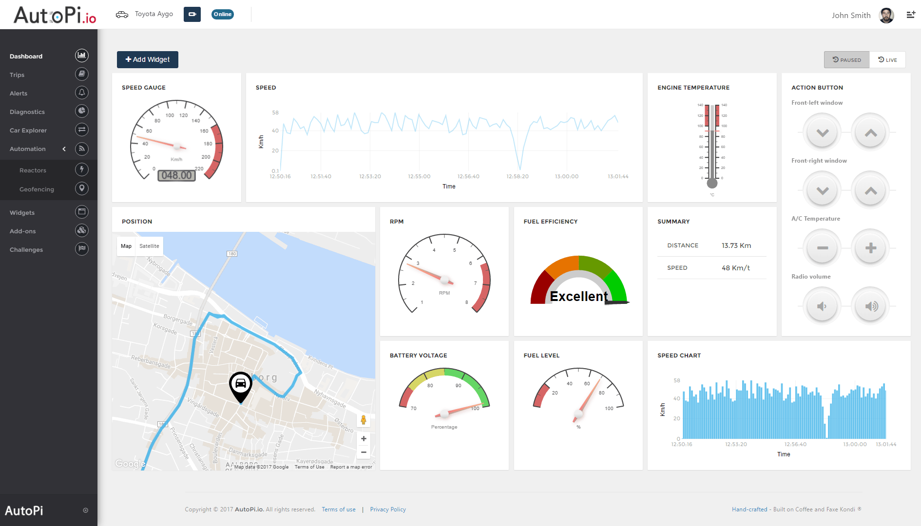
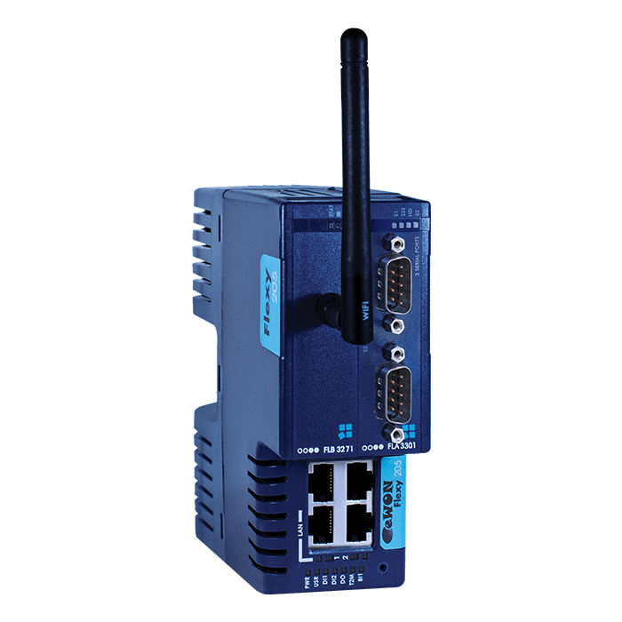
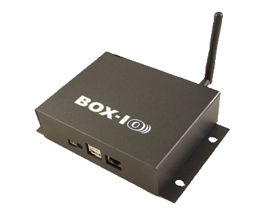
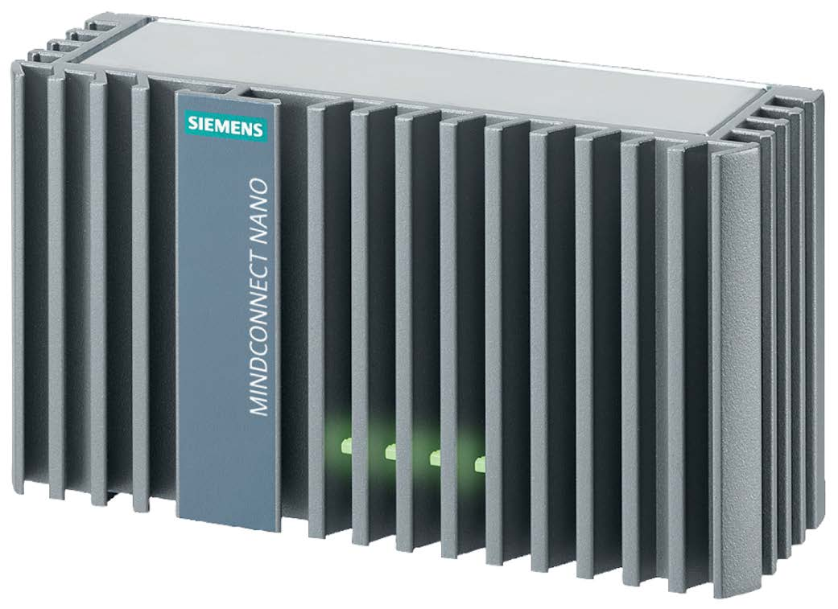
Common Features
IIoT solutions are composed of two parts
access to a cloud dashboard to
configure the service
pair the IIoT gateways
visualize stored data
perform data analysis
a set of IIoT gateways
data collection from PLCs
small local data buffer
data is sent to cloud
Notes:
All solutions are usually composed of two parts:
1 A dashbord located in the cloud (usually) that allow to control and configure the service
2 one or more solutions to connect to the cloud platform and send/receive data: open libraries or IIoT gateways

Slide 30

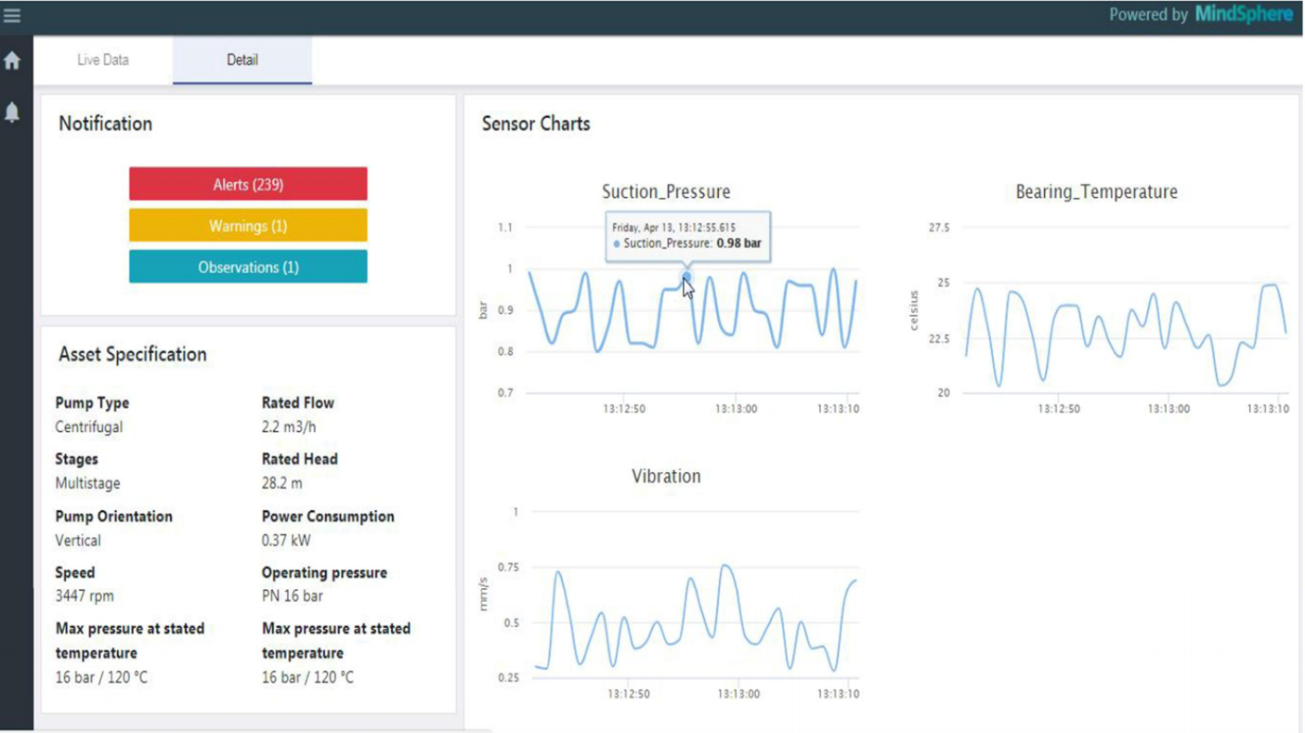
Siemens MindSphere
IoT operating system from Cloud dashboard
concept of apps executed in the cloud
advanced data analytics
fast development of industrial solutions
data visualization
machine learning app
Many data sources
MindConnect Nano
MindConnect IoT2040
MindConnect Lib
MindConnect IoT Extension
Notes:
Siemens has its solution which is very easy to configure and flexible.
The dashboard allows, through apps developed by Siemens and third party entities, to do every computation and visualization
Different data sources are supported: starting from MindConnect Nano and IoT2040, which connects directly to PLCs, to a open source library to custom devices to IoT extensions that allows to interface with other things.
It is also possible to extract data from Oracle Databases, SAP solutions, …

Slide 31

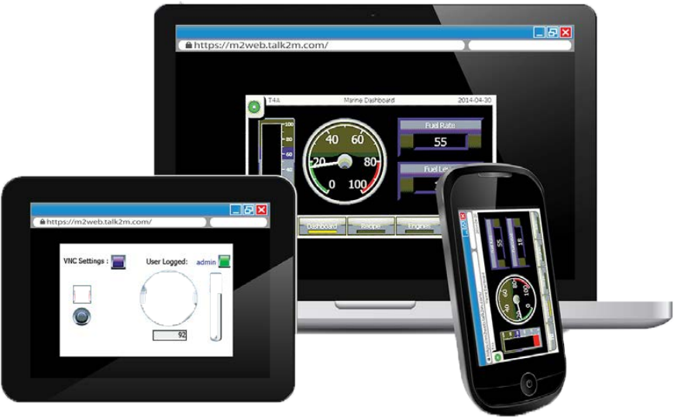
eWON
The company has its own solution M2Web
provides secure access to PLCs, HMI, …
pc, mobile, tablet supported
access through Vpn
Monitor and control PLCs
Flexy M2M Data Gateway
PLC form factor
support for many PLC brands to collect data (Siemens, ABB, Omron, …)
support for many cloud services to store data (MindSphere, AWS, Azure, …)
Notes:
eWON is an HMS company which provides their solution to access PLCs/HMIs via cloud dashboard (or VPN)
Interesting IIoT gateway is the Flexy: it captures data from all kind of PLCs, and send them to every kind of cloud platform, from Microsoft Azure to MindSphere

Slide 32
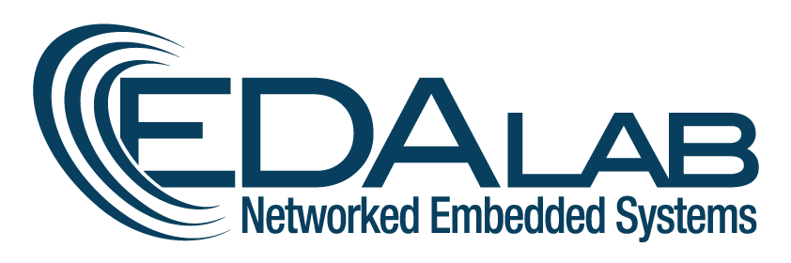
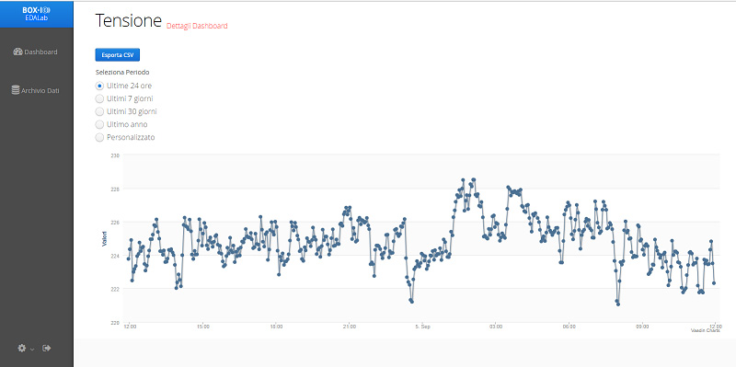
Commercial Solutions - BOX-IO
IoT monitoring solution from
Cloud dashboard
monitor and control IoT devices
can also aggregate data
customizable solution
BOX-IO Gateway
various IT/OT protocols supported
zigbee, modbus, ethernet, wifi
broad range of sensors/actuators supported
local buffering storage
easily extensible
embedded gateway or embedded software
Notes:
BOX-IO is the solution by Edalab which can be easily extended to met all customer requirements.

Slide 33
An Industrial Use Case
ICE Laboratory
Notes:
ICE Lab is the proud project of UniVR which aims to create a lab Industry 4.0 compliant with innovative technologies

Slide 34
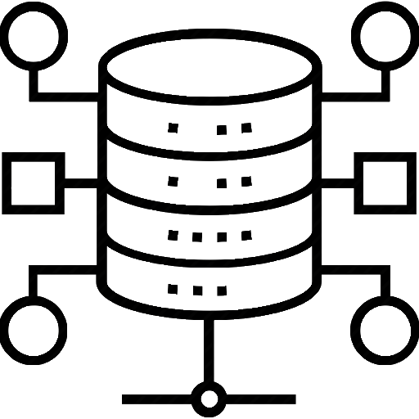
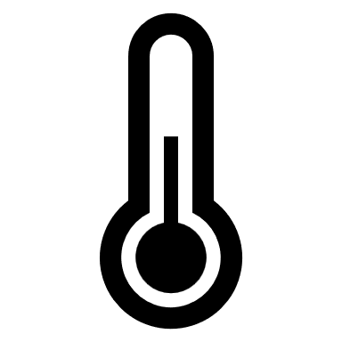




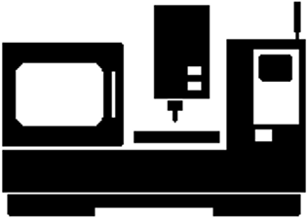
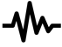

Concrete scenario
Service layer
Network layer
Cloud
Device layer
Content layer
Notes:
Vogliamo monitorare l’ambiente lavorativo e lo stato dei macchinari quindi vengono installati dei sensori. Questi poi devono comunicare con l’arch dati per così poter fare delle analisi.

Slide 35
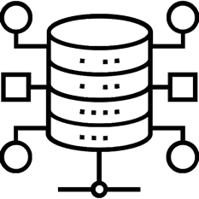
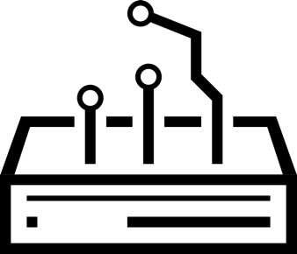
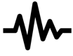
Connecting devices
PROBLEM
Absence of a unique standard for communication between sensors and central processing
The sensors cannot be connected directly to the IP/internet network
ß æ ç ã ø Đ Ă Ü ã ð ø ç Ą õ
Cloud
SOLUTION: Gateway
Support different protocols
Connect devices to the internet
Provides an additional level of security
Pre-process data
Reduce transmission size
jsnf-34_x y_kwfnl-907
Ⴧ ტ დ ჵ ჟ თ Პ ჵ ვ ჽ Ⴭ ჵ ჳ
f▲φ♦▼φ Ω Σ ♦ µ Ω ε
ß æ ç ã ø Đ Ă Ü ã ð ø ç Ą õ
Notes:
I sensori e anche l’arch dati comunicano con protocolli diversi
A volte, nella stessa rete, coesistono diversi protocolli, standard e tecnologie
E questo è uno dei problemi principali per la diffusione dell’IoT, ovvero, l’assenza di uno standard univoco per la comunicazione tra sensori ed elaborazione centrale.
Un altro problema è che i sensori possono non essere direttamente collegati alla rete IP/internet
La soluzione quindi è l’utilizzo di un gateway
Il gateway è un dispositivo che
Supporta diversi protocolli e permette di connettere dispositivi senza accesso diretto a internet
Offre livello aggiuntivo di sicurezza proteggendo i dati dal gateway all’arch dati
Può pre-elaborare i dati e in questo modo si può ridurre la dimensione della trasmissione

Slide 36
Which protocol?
ß æ ç ã ø Đ Ă Ü ã ð ø ç Ą õ
The choice of protocols depends on:
Wired or wireless
Sensor-gateway distance
Bandwidth
Latency
Energy consumption
(I)IoT protocols
Wi-fi, Ethernet, Modbus, Bluetooth, Zigbee, NFC, LoRaWAN, …
Cloud
jsnf-34_x y_kwfnl-907
Ⴧ ტ დ ჵ ჟ თ Პ ჵ ვ ჽ Ⴭ ჵ ჳ
f▲φ♦▼φ Ω Σ ♦ µ Ω ε
ß æ ç ã ø Đ Ă Ü ã ð ø ç Ą õ
36
Notes:
Nel mondo dell’(I)Iot ci sono molteplici protocolli. Come scegliere quello adatto al nostro caso?
La scelta dei protocolli dipende principalmente da questi 5 caratteristiche:
La presenza o meno di un collegamento fisico (cablati o senza fili)
La distanza tra i sensori e i gateway
La quantità di dati che è necessario trasmettere nel tempo (ampiezza di banda)
Il ritardo con cui i dati possono arrivare (latenza)
Il consumo energetico

Slide 37
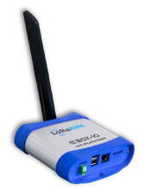
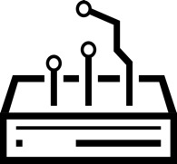
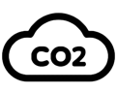
Data acquisition system implementation
GOAL: to monitor the working environment and equipment status
Steps:
Cloud
[1]
Data to monitor
Sensoristics
Sensors integration in the gateway
Interface the gateway with an data architecture
Installation and Test
[1] https://www.box-io.com/
Notes:
Per monitorare l’ambiente e lo stato dei macchinari, si inizia facendo un sopralluogo, quindi quali dati si vogliono o è necessario monitorare
Quali dati da monitorare: fare il sopralluogo
Sensoristica: lista dei sensori da installare, dove installare, creare lo scenario, costruire l’architettura (sensori, gateway, cloud/arch dati)
Integrazione dei sensori: interfacciamento con il gateway, testare l’accuratezza dei dati e installare i sensori poi nel sito
Invio dei dati in un’architettura dati:
Installare sul luogo di sensori, gateway

Slide 38
Sensors integration
Data to monitor
Choose the data to collect
Sensoristics
Sensors integration in the gateway
Sensor already installed
Sensor not installed
Interface the gateway with an data architecture
Installation and Test
Choose the most suitable sensor
Protocol supported by the gateway
Protocol not supported by the gateway
Add protocol to the gateway
Integration of the sensor to the gateway
Test phase

Slide 39

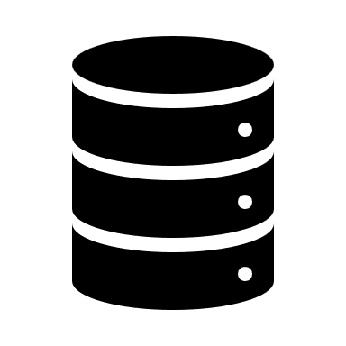







ICE Lab: Data collection
Cloud
ICE Lab
NO-SQL DATABASE
DATA UPLOADER TO CLOUD
PERSISTENT DATABASE
Cloud
DATA BUFFER (NOT PERSISTENT DATA)
DATA UPLOADER
DATA ANALYSIS MODULE
Data collection architecture that relies on Kubernetes and OPC-UA
OPC-UA CLIENT
OPC-UA SERVER

Slide 40

ICE lab: IoT Data Viewer​
Smoke
Light
Occupancy
Dimmable light
Humidity
Brightness
Temperature
CO

Slide 41

ICE lab: IIoT Data Viewer​
UP actuation counting
DOWN actuation counting
Actuation counting
Total working time of motor
Motor status

Slide 42
An HC4.0 Use Case
ThingSpeak application
Notes:
ICE Lab is the proud project of UniVR which aims to create a lab Industry 4.0 compliant with innovative technologies

Slide 43
The structure
An Arduino Nano connected to a keypad,
a monitor and an HR sensor collects data and sends them trough MQTT to ThingSpeak
Through MatLab and the ThingSpeak toolbox the data are retrieved from ThingSpeak and plotted in two tables
ThingSpeak collects the data in 4 tables.
Each tuple of data as a specific timestamp which is useful to reconnect the data

Slide 44
What’s the goal?
By collecting enough data , it could be possible to have a table with:
the real medical values
that people of that weight and height category should have
With this information, it could be possible:
to improve early diagnosis of health pathologies,
if the device were wearable and kept on monitoring the BPM,
in case of an emergency, a really fast response through data analysis can be obtained
and not by an actual person who has to look at those parameters 24/7

Slide 45


How the Data are Collected
The user is asked to insert his age, height (cm) and weight (kg) through the keypad
Later is asked to insert a finger into the spring device that keeps the pressure on the HR sensor steady, the sensor measure the pulse for 15 seconds and then return the avarage HR.
The data collected are then sent trough an MQTT client to ThingSpeak that stores them in 4 tables

Slide 46

The Electrical Schema
Keypad 4x4
Matrix
Max30102
HR Sensor
16x02 Lcd with I2C signal converter,
(integrated on board)
Arduino nano ESP32

Slide 47

The Collected Data
The raw data themselves lack of meaning and need to be precessed.
Each of the tables produced by ThingSpeak contains one of the data collected from the IoT device: age, height, weight and avg BPM

Slide 48

Processed Data
Through MatLab is possibile to elaborate the data, with the height and the weight is possible to calculate the BMI (Body Mass Index) of a person.
Here there are two tables, both of them divide the people by age and the one on the top divides also by weight while the bottom one by BMI.
The BPM in those cells is the average beetwen all the people of that same category.

